Slide 1

College Management System
A Presentation by Giri
Montreal University

Slide 2

About Project
College Management System is designed as portal for interactions between students and teachers.
Managing attendance, marks, time table and generate reports of students.
Students can access their data and get updated by teachers.
A common login page for students and teachers.
A college management system built using Django framework.

Slide 3

Technology Stack
A Dynamic Framework with Popular Programming Language
Python & Django Framework have done all the work
Git & Gitbash
Devops Tools for CI/CD – Jenkins
Terraform with AWS Cloud for Robust Infrastructure
Front end: HTML/CSS/Bootstrap
Database: MySQL database

Slide 4

Windows Server 2022
A Dedicated Server for High Availability
AWS EC2 Instance Resource
AWS Automation by Terraform – Infrastructure As Code
Windows Server 2022 Free Tier with RDP Port Open
Auto Scaling & Load Balancer for Handling Traffic
Continuous Monitoring using AWS Cloud Watch Service

Slide 5

College Management System On the Go
Implemented the college management system with certain capabilities that fix the system's present issues, such as the ability to alter attendance and grades prior to locking the system. The application was also evaluated using multiple testing techniques, with good results.

Slide 6
Code & Modules in the system
The project was implemented in the form of a website using Django framework (python).
Student Portal
Teacher Portal
Login
Home Page
Attendance
Marks
Time Table
Login
Homepage
Attendance - Enter & Edit Attendance
Marks - Enter & Edit Marks
Timetable
Reports

Slide 7

Reason Behind Application
The purpose is to design software for college database which contains up to date or accurate information of the college. That should improve efficiency and flexibility of college.

Slide 8
Product Features
Each teacher will be able to enter attendance and marks for their respective students.
The teachers will be able to apply for various types of leave directly through the system.
Each student will be able to view the attendance status for their respective courses.
The students will be able to Communicate and provide feedback to their teachers.
The students will have access to a forum page where they are communicate will each other.
The administrator will be able to view and update information such as departments, classes, teachers, students, & courses.

Slide 9
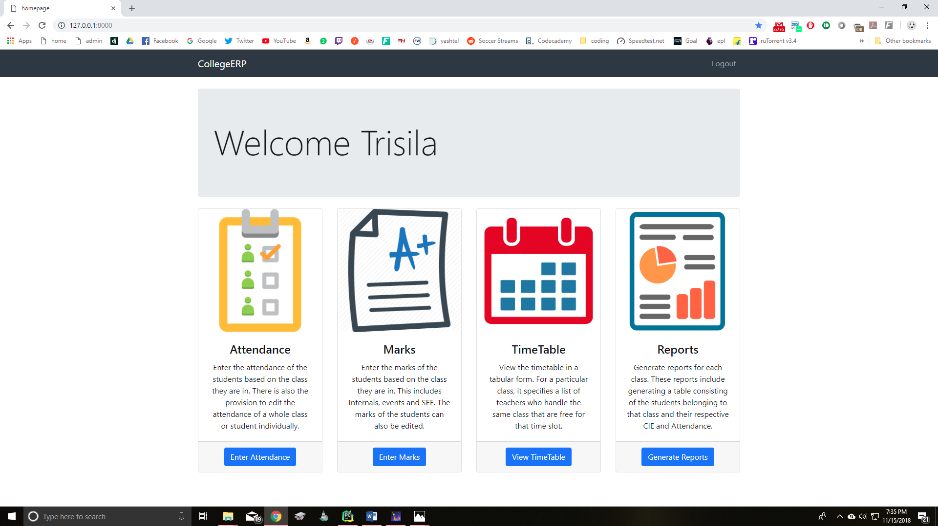
Teacher Portal to Access Student Data

Slide 10
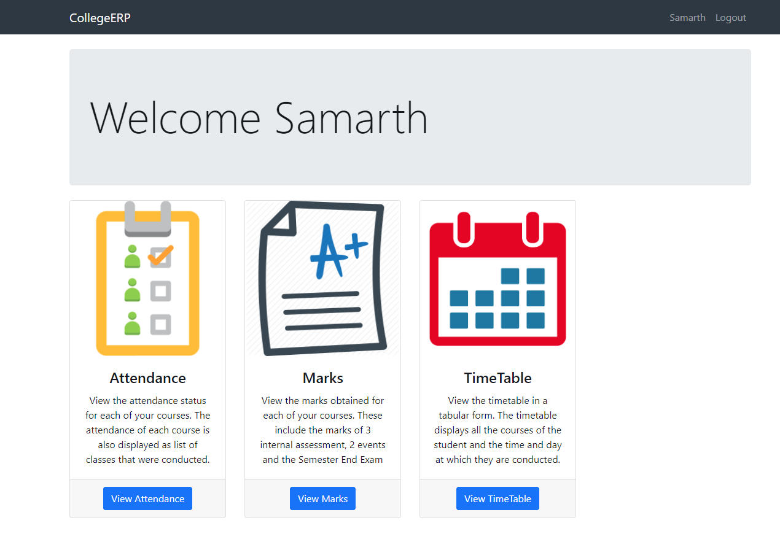
Student Portal to Access Complete Data

Slide 11
Application Info
Application deployed on Windows Server with Static IP → 172.31.12.138 (Private IP)
To make public availability → Server Settings made to allow all ip address & port 8000 opened for handling incoming traffic through windows firewall.
To create super admin user → python manage.py createsuperuser
The admin page is used to modify all tables such as Students, Teachers, Departments, Courses, Classes etc.
The server can be accessed through http://public_ip:8000 (Here AWS elastic ip service can be used to maintain static ip)
Admin page can be accessed through http://public_ip:800o/admin
We can control the access to the application through ip address allowed lists as part of security concern.
To handle load and high availability of server load balancer & auto scaling can be implemented.
A domain can be connected and use the application with ease.

Slide 12
Thank You So Much
Thank you very much, Montreal University, for providing me with a wonderful learning platform.
I've earned exceptional talents in application development and design for corporate and commercial needs.
A special thank you to every faculty member for sharing your expertise and quality of knowledge.
I'm thrilled to be a member of the Montreal University, and I'm eager to utilize the abilities I've acquired to meet business objectives.

